Slide 1
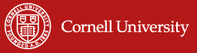
Why IBLI?
On Poverty Traps, Catastrophic Risk
and Index Insurance
Christopher B. Barrett
Index Based Livestock Insurance Mini Workshop International Livestock Research Institute, Nairobi, Kenya
July 24, 2012

Slide 2
Motivation: Poverty Traps And Catastrophic Risk
Pastoral Risk Management (PARIMA) project (1997-2007) found strong evidence of poverty traps in the arid and semi-arid lands (ASAL) of northern Kenya and southern Ethiopia.
Catastrophic herd loss risk due to major droughts identified as the major cause of these dynamics.
Source: Lybbert et al. (2004 EJ) on Boran pastoralists in s.Ethiopia. See also Barrett et al. (2006 JDS) among n. Kenyan pastoralists, Santos & Barrett (2011 JDE) on s.Ethiopian Boran.

Slide 3
Motivation: Increased Risk From Climate Change
Pastoralist systems adapted to climate regime. But resilient to a shift in climate? Many models predict increased rainfall variability (i.e., increased risk of drought).
Herd dynamics differ b/n good and poor rainfall states, and so change with drought (<250 mm/ year) risk.
In southern Ethiopia, doubling drought risk would lead to system collapse in expectation in the absence of any change to prevailing herd dynamics.
Source: Barrett and Santos, in review

Slide 4
Motivation: Standard Responses to Drought
Standard responses to major drought shocks:
1) Post-drought restocking
2) Food aid
Key Problems:
Slow
Expensive (in part, because it’s slow)
Targeting challenges
Food aid can reinforce sedentarization/foster dependency
Core issue: If transfers go only to the poor who are already in the poverty trap, the numbers of poor will grow as shocks knock others below the poverty trap threshold. In the long-run, the ex ante poor worse off as others join their ranks and compete for scarce social assistance resources. (see Barrett, Carter & Ikegami 2012 for more general theory/illustrations)

Slide 5
Alternative Responses: Insurance?
Commercially sustainable insurance can:
  Prevent downward slide of vulnerable populations
  Crowd-in investment and accumulation by the poor
  Induce financial deepening by crowding-in credit
  Let us focus humanitarian resources on the needy
But can insurance be sustainably offered in the ASAL?
Conventional (individual) insurance unlikely to work, especially in small scale agro-pastoral sector:
  Very high transactions costs, esp. w/little financial intermediation among pastoralists
  Moral hazard/adverse selection

Slide 6
The Potential of Index Insurance
Index insurance is a variation on traditional insurance:
  Do not insure individual losses.
  Instead insure some “index” measure that is strongly correlated with individual losses. (Examples: rainfall, remotely sensed vegetation index, area average yield, area average herd mortality loss). Index needs to be objectively verifiable, available at low cost in real time, and not manipulable by either party to the contract

Slide 7
The Potential of Index Insurance
Index insurance can obviate the problems that make individual insurance unprofitable for small, remote clients:
  - No transactions costs of measuring individual losses
  - Preserves effort incentives (no moral hazard) as no single individual can influence index
  - Adverse selection does not matter as payouts do not depend on the riskiness of those who buy the insurance
Index insurance can, in principle, be used to create a timely, financially sustainable, self-targeting safety net to protect pastoralists against catastrophic drought shocks.
Could also accelerate herd recovery, altering herd dynamics and averting system collapse if drought frequency increases. Perhaps crowd in value-adding investments, too!

Slide 8
The Major Challenges of Index Insurance
High quality data (reliable, timely, non-manipulable, long-term) to design/price product and to determine payouts
Minimize uncovered basis risk through product design. Is it insurance or a lottery ticket? All turns on basis risk!!!
Innovation incentives for insurers/reinsurers to design and market a new product and global market to support it
Establish informed effective demand, especially among a clientele with little experience with any insurance, much less a complex index-based insurance product
Low cost delivery mechanism for making insurance available for numerous small and medium scale producers

Slide 9
Conclusions
Poverty traps pose a major development challenge.
Where they arise due to climate shocks, such as drought, climate change can be especially threatening.
Standard drought responses have proved largely ineffective.
Traditional insurance not viable in pastoral areas.
Index insurance, in principle, could be very effective.
But major challenges exist to developing/scaling index insurance to address this problem.
That’s why IBLI is so exciting … and why it remains a serious research project, not just a commercial project.

Slide 10
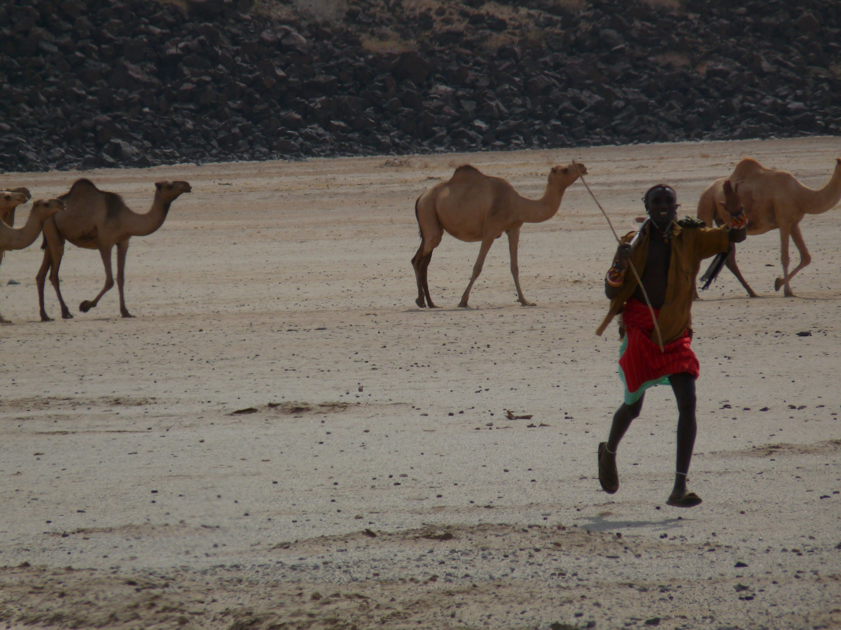
IBLI appears a promising option for addressing poverty traps that arise from catastrophic drought risk
Thank you for your time, interest and comments!
For more information visit www.ilri.org/ibli/
Notes:
10

